Slide 1

TDB – Tibet Digital Bank
Finance: digital currencies, taxation, and sovereign wealth management.
Innovative Financial Solutions for E-Tibet: Winning Strategies Using Blockchain & Digital Finance
Introduction:
We stand before you today to propose groundbreaking financial solutions for E-Tibet, aiming to revolutionize its economic landscape through innovation and technology.
Our goal is to create a robust financial infrastructure that incorporates cutting-edge technologies including Web3, blockchain, and digital finance to address E-Tibet’s unique challenges and capitalize on emerging opportunities.

Slide 2
Ideation & Planning
Requirements
TDB
What are Tibet's financial challenges?
Introducing a Stable coin or Central Bank Digital Currency (CBDC) specifically tailored for E-Tibet.
Tibet Digital Bank Coin
How can digital currency help governance and economy?
Ensuring stability, security, and widespread accessibility to foster economic participation and development.
How do we automate taxation while ensuring trust?
How can we manage wealth for future growth?

Slide 3
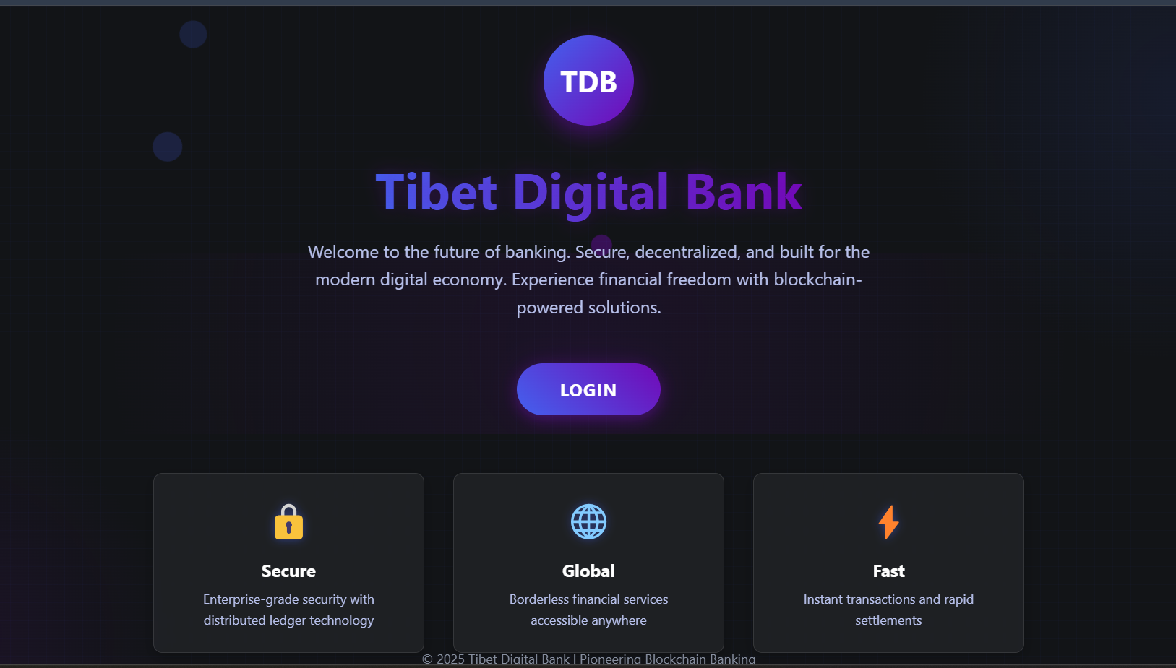

Slide 4

Architecture & Smart Contract Development
Digital Currency
Taxation Model
A Tibetan Digital Bank Coin (TDB Coin) as a stablecoin (ERC-20) with staked reserves (gold-backed or algorithmic).
Smart contracts deduct taxes automatically from transactions. Users choose between income tax, transaction tax, or staking tax.
Sovereign Wealth Management
Treasury smart contract to allocate funds. DeFi staking to generate passive income. Voting contract for fund allocation.
Smart Contract Development (Solidity/Rust): Token contract (ERC-20), Tax contract (auto-deduction), Treasury management contract, Voting contract for fund allocation.

Slide 5


Benefits of TDB
Economic Inclusion: Increased access to formal banking services for all residents, fostering financial inclusion and empowerment.
Transparency: Streamlined governance processes and reduced corruption through decentralized ledger systems.
Innovation Hub: Positioning E-Tibet as a leader in fintech innovation, attracting talent and investments.
Sustainable Growth: Strategic allocation of resources towards education, healthcare, and infrastructure, driving socio-economic progress.

Slide 6



Frontend Development & Wallet
Integration
User Dashboard
Display wallet balance, tax deductions, and investments. Allow transactions & treasury voting.
Wallet Integration
Integrate MetaMask or Solana Wallet for seamless user experience.
Real-time Data & Visualization
Charts for tax revenue & sovereign wealth fund. Transaction history tracking.

Slide 7

Key Winning Factors
Innovation
Unique tax & sovereign wealth model.
Functionality
A working smart contract & app.
User Experience
Simple & intuitive UI.
Real-world Application
Feasible adoption for E-Tibet.
Focusing on innovation, functionality, user experience, and real-world application will increase the chances of winning the hackathon. Let's Build & Win This Hackathon!

Slide 8
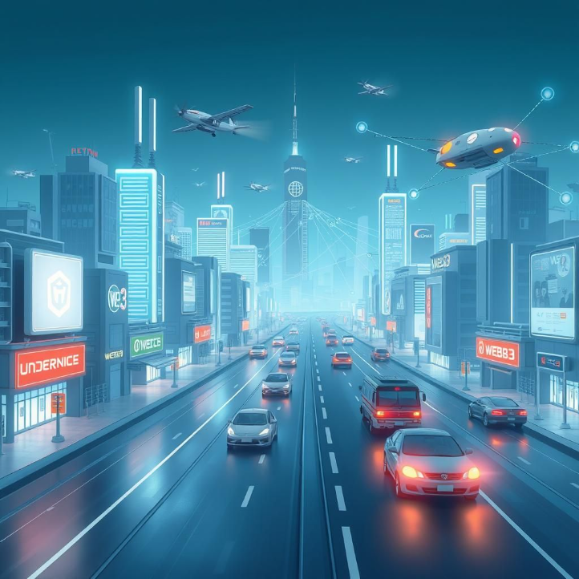
Conclusion
By adopting these forward-thinking financial solutions, E-Tibet stands poised to become a beacon of modern economic transformation, setting a precedent for regions worldwide seeking to leverage blockchain and digital finance for inclusive and sustainable development.
Join us in this transformational journey; together, let's shape the future of E-Tibet and inspire change across the globe.

